Slide 1
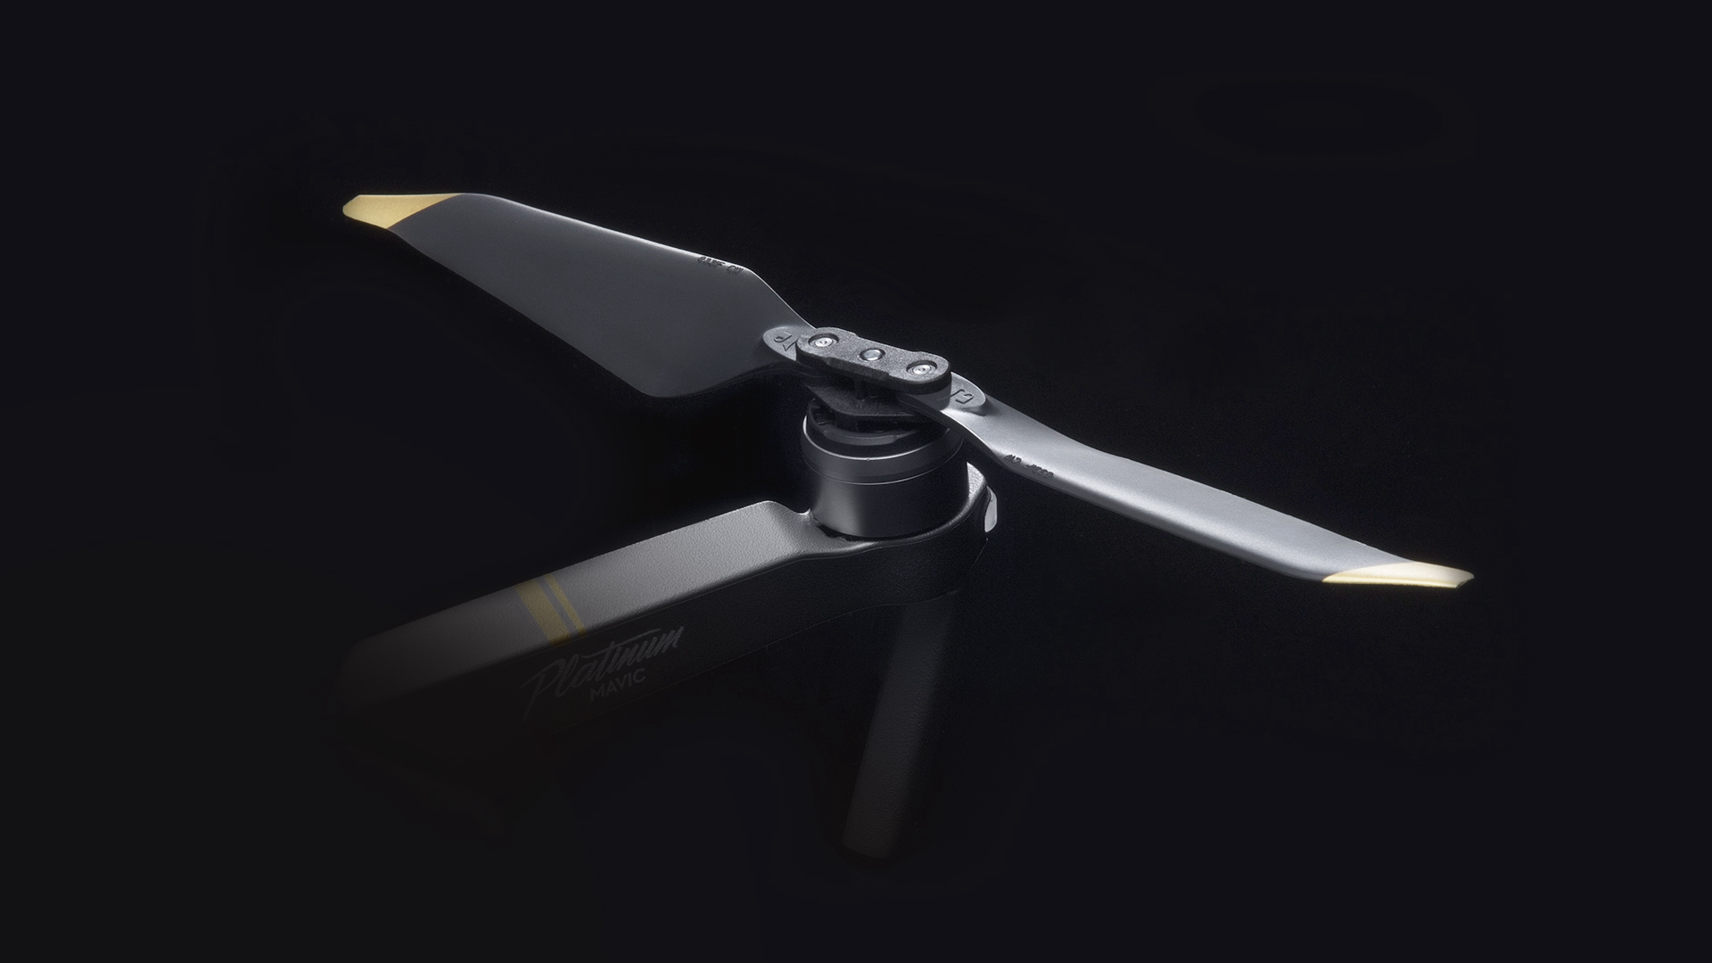
Designing the Future Propeller
By Zander Farr

Slide 2
Nature of the project
Design a propeller with current knowledge and theory to produce minimal noise with maximum efficiency.
With emerging drone technology we need more economical drone propellers for company operations.
Package Deliveries
Land Surveying
Military Missions
With better efficiency we can use these drones longer and more cost effective. With something as simple as a propeller we could give this new industry an opportunity to expand faster and easier.

Slide 3
Plan of Attack
Gather all needed software and resources
SolidWorks, Thrust Stand, Basic Propellers, Motors, Electronic Speed Controllers, Drone Frame, Fusion 360, LiPo Batteries, Propeller Theory and AeroSpace Literature.
Study Propeller and Aerospace Theory
Annotated Sketches of my first few design concepts
Design my first propeller via SolidWorks
Do some preliminary flow simulations to get used to the software
Learn from flow simulations and fix the issues
Perform mathematical analysis of my final design
3D print my design at the Keenan Center
Check for quality control and reprint as necessary
Attach to thrust stand and collect data
Compare to traditional propellers
Summarize

Slide 4
Timeline
Collecting resources – Finished everything but the thrust stand and RCBenchmark Software
Study theory and research – Completed by September 6th
Annotated Sketched – Completed by September 13th
First Design and preliminary flow simulation – Completed by September 20th
Refining Design – Completed by September 27th
Mathematical Analysis – Completed by October 4th
3D Printing and Quality control – Completed by October 11th
Data collection – Completed by October 25th
Refine my design and test again – Completed by November 8th
Compare Data to traditional Propellers – Completed by November 15th
Prepare Final Presentation and Project Summary – Completed by December 6th

Slide 5
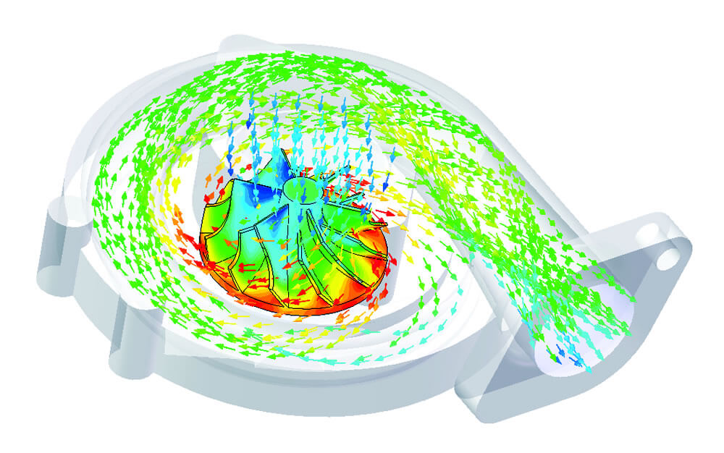
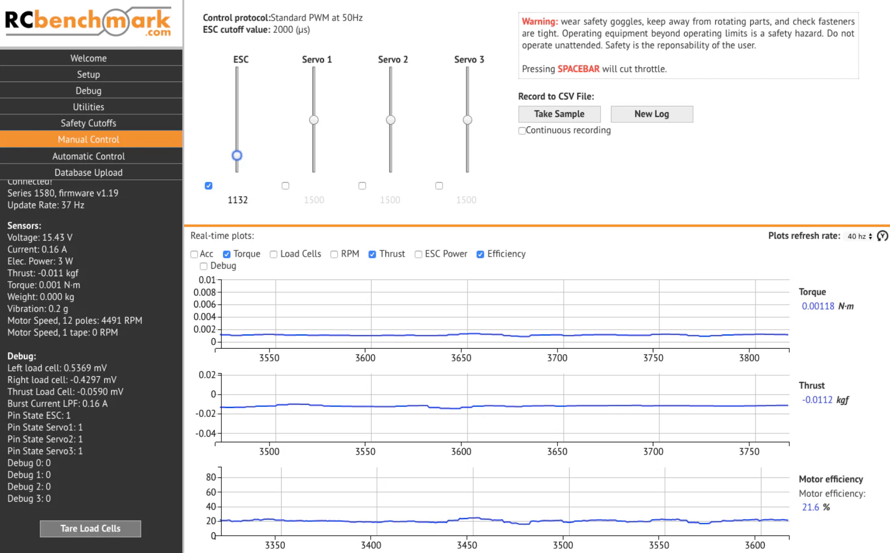
Programs Needed for Development and Research
SolidWorks
Flow Simulations
RCBenchmark
Collecting data
Excel
Analyzing Data

Slide 7
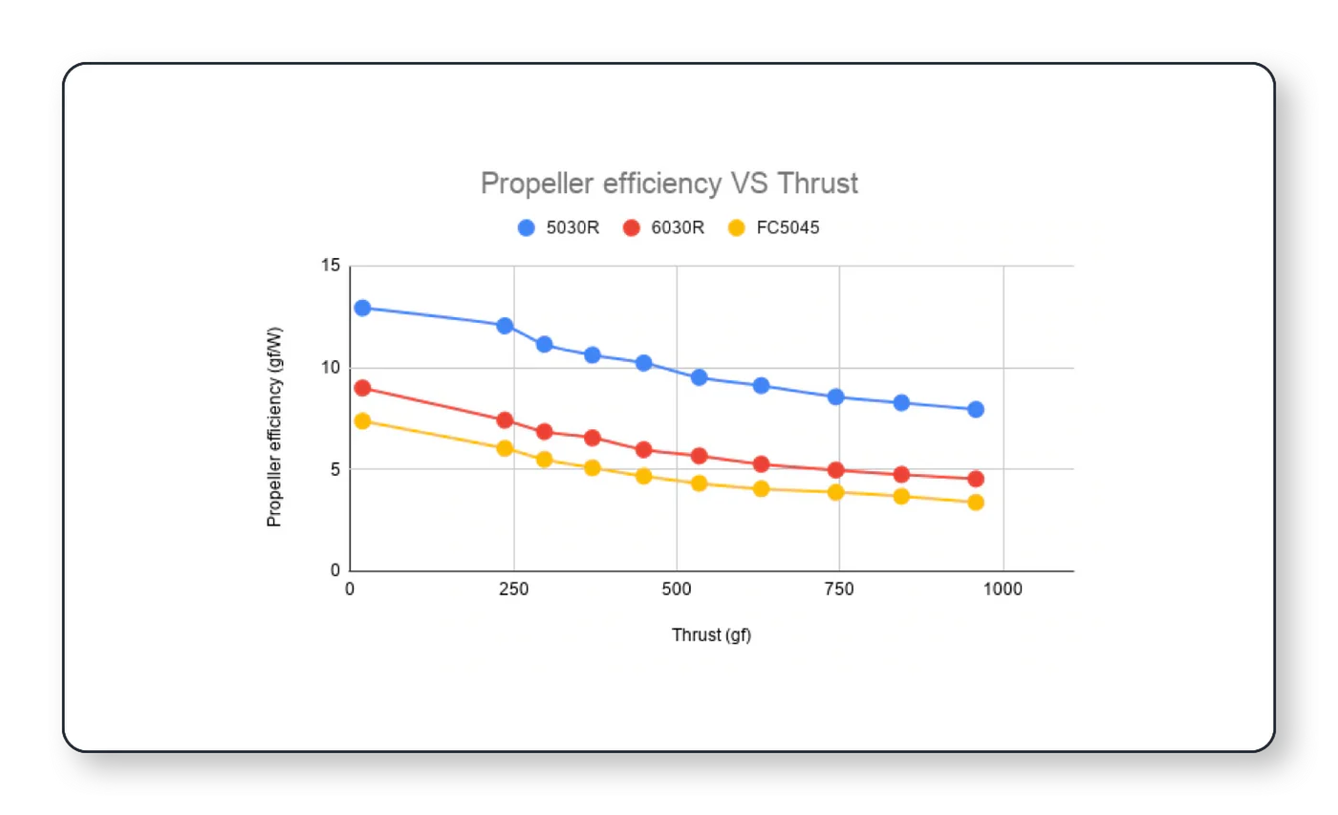
How I will be testing
If I am able to get my hands on a flight thrust stand I will be using that to collect my data like thrust values, voltage, torque, Rotations Per Minute (RPM), Motor Resistance.
The derived data will include the Power Efficiency, Mechanical Power, Electrical Power, Motor Efficiency, Overall System Efficiency, Airspeed.
I will then compare all of my data with traditional propeller and then some of the new industry leading toroidal propellers to see how my design compares.

Slide 8
Tyto Robotics (Proposal)
Tyto Robotics is a company that deals with in depth motor and propeller testing.
My Goal is to get the Series 1585: Drone Thrust Stand
Valued at $1,075
Features
3 load cells for capturing data
No-solder board to easily test different motors
Comes with RCbenchmark software that gives real time thrust, torque, power consumption, efficiency, current and voltage data.
Exportable data tables to then analyze each component of the test.

Slide 9
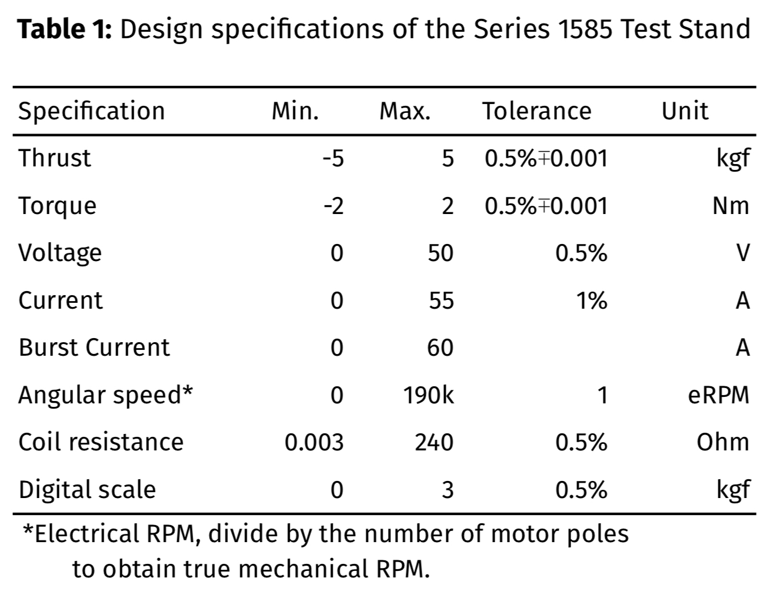
Tyto Robotics: 1585 Thrust Stand Design Specifications

Slide 10
Supplementary Goals
Design and test my propellers with my own 3D printed drone to see how they compare to real life conditions.
Drone frame and design has been started via Fusion360
Look into getting this propeller professionally developed

