Slide 1
Capturing Wind Energy from Highways and Train Tracks
A New Design for the Windmill Turbine
Belal Aly

Slide 2
01
The idea

Slide 3
The idea
Create a more efficient propeller to store wasted energy
Help the environment by providing more ways of aquiring clean energy

Slide 4
02
The Plan

Slide 5
The plan
Mechanical design
Utilize Bernoulli's equation
Horizontal design
$$p_{a}+\frac{1}{2}ρV_{a}^{2}+ρgh_{a}=p_{b}+\frac{1}{2}ρV_{b}^{2}+ρgh_{b}$$
If the volume of flow decreases, the flow speed increases to keep ratio constant
This project focuses on the mechanical part of the wind turbine.
Not the Electrical part
Lots of vertical designs out there that capture only a part of the wind flow

Slide 6
Project timeline
Design WGA
(wind guiding apparatus)
Simulate wind
Conclude WGA design
Design the shaft holder
Design blade
3D print
Test
Conclusion

Slide 7
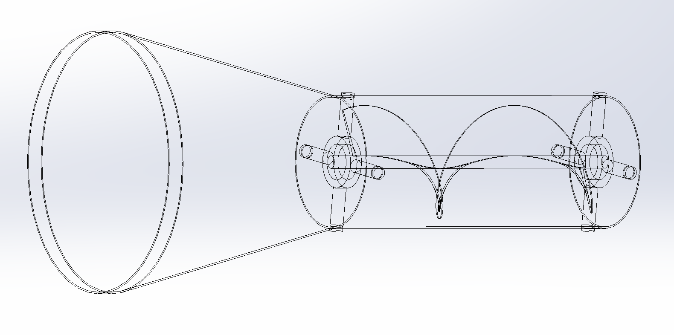
03
The Design

Slide 8
WGA (wind guiding apparatus)
Funnel
Cylindrical body
Acts as the air intake
Increases the airflow speed
Houses the blade
Guides air so that it contacts the blade from only one direction

Slide 9
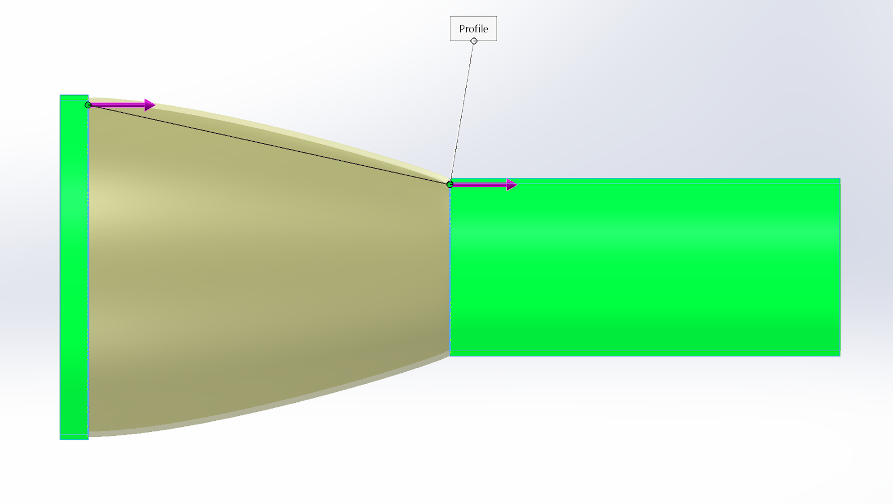
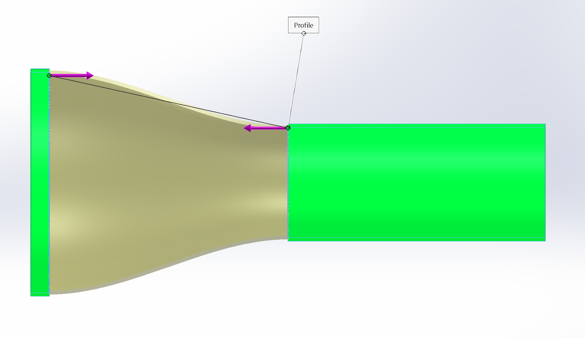
Funnel Previous Design
300mm
300mm

Slide 10
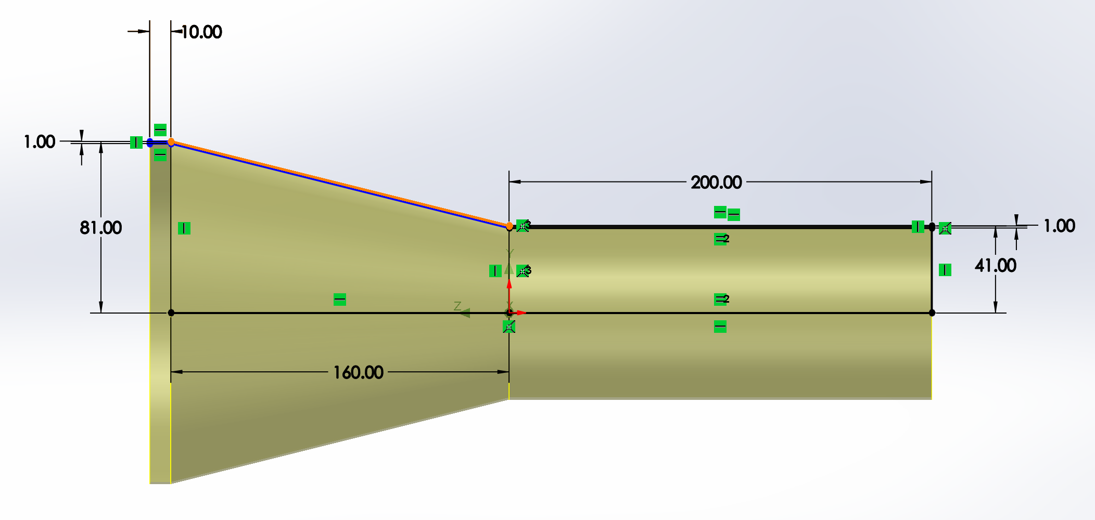
Funnel Current Design
R
r

Slide 11
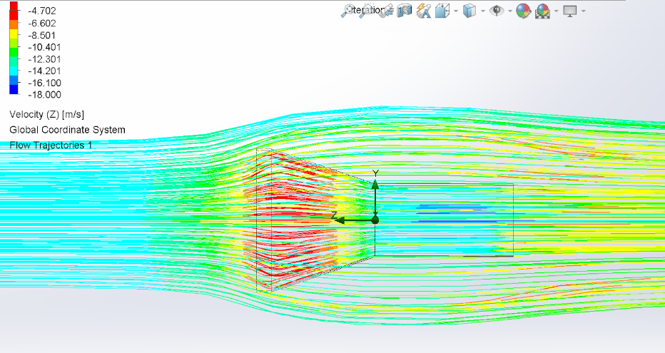
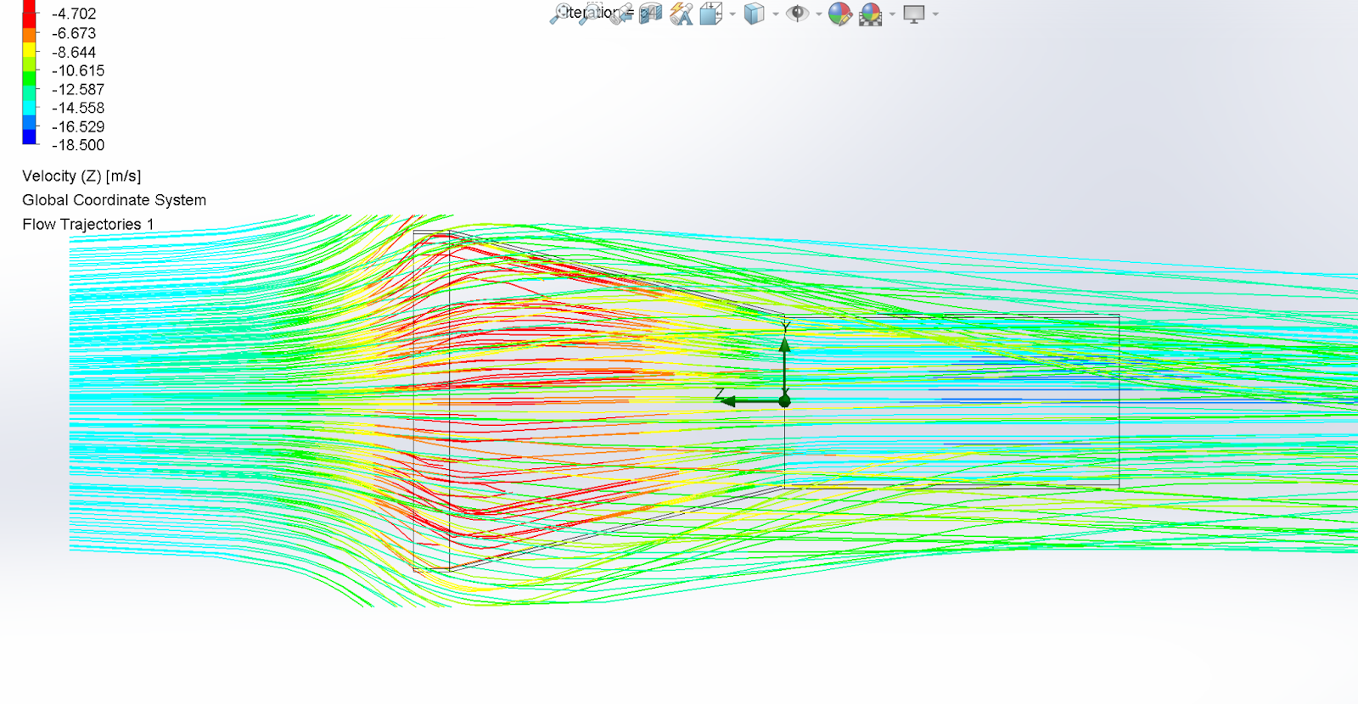
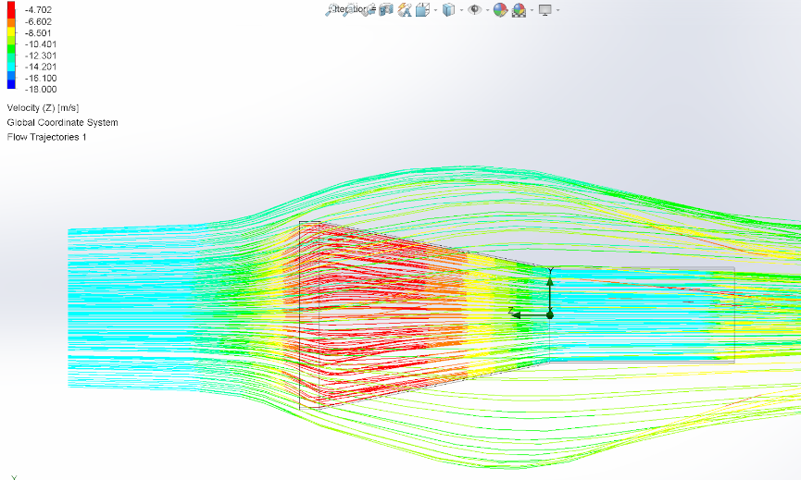
Funnel Simulation
15 m/s
18.5 m/s

Slide 12
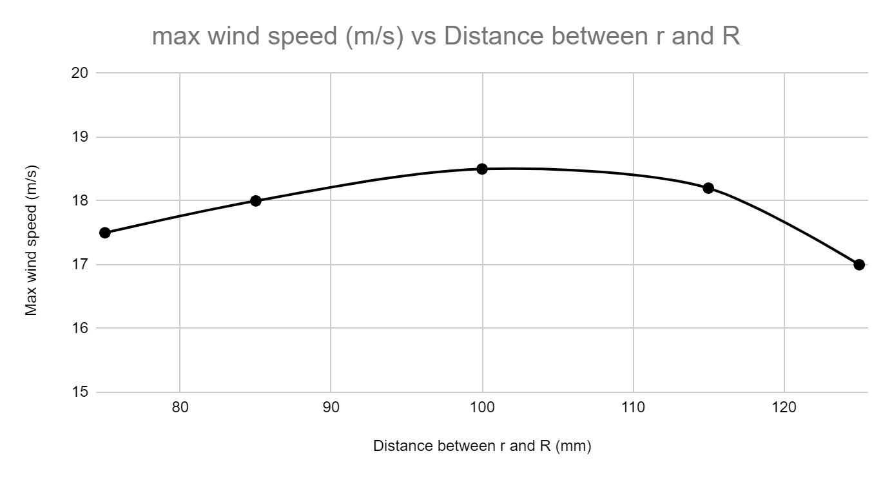
Flow Simulation Through Funnel
Slope = 1/2

Slide 13
Funnel Current Design
R
r
3D printer build height max is 400mm.
The lengths had to be adjusted with the same slopes and proportions.

Slide 14
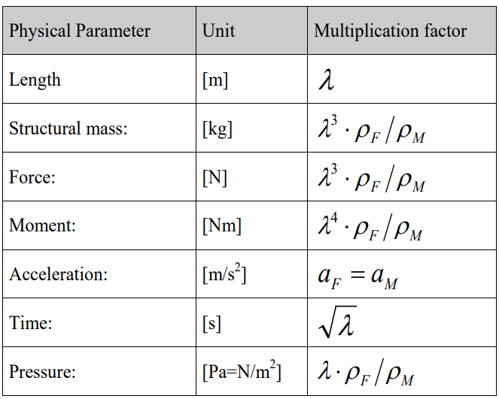
Froude Laws of scaling
By keeping the dimensions ratio the same, the model (M) and full scale (F) will experience the same Forces over time

Slide 15
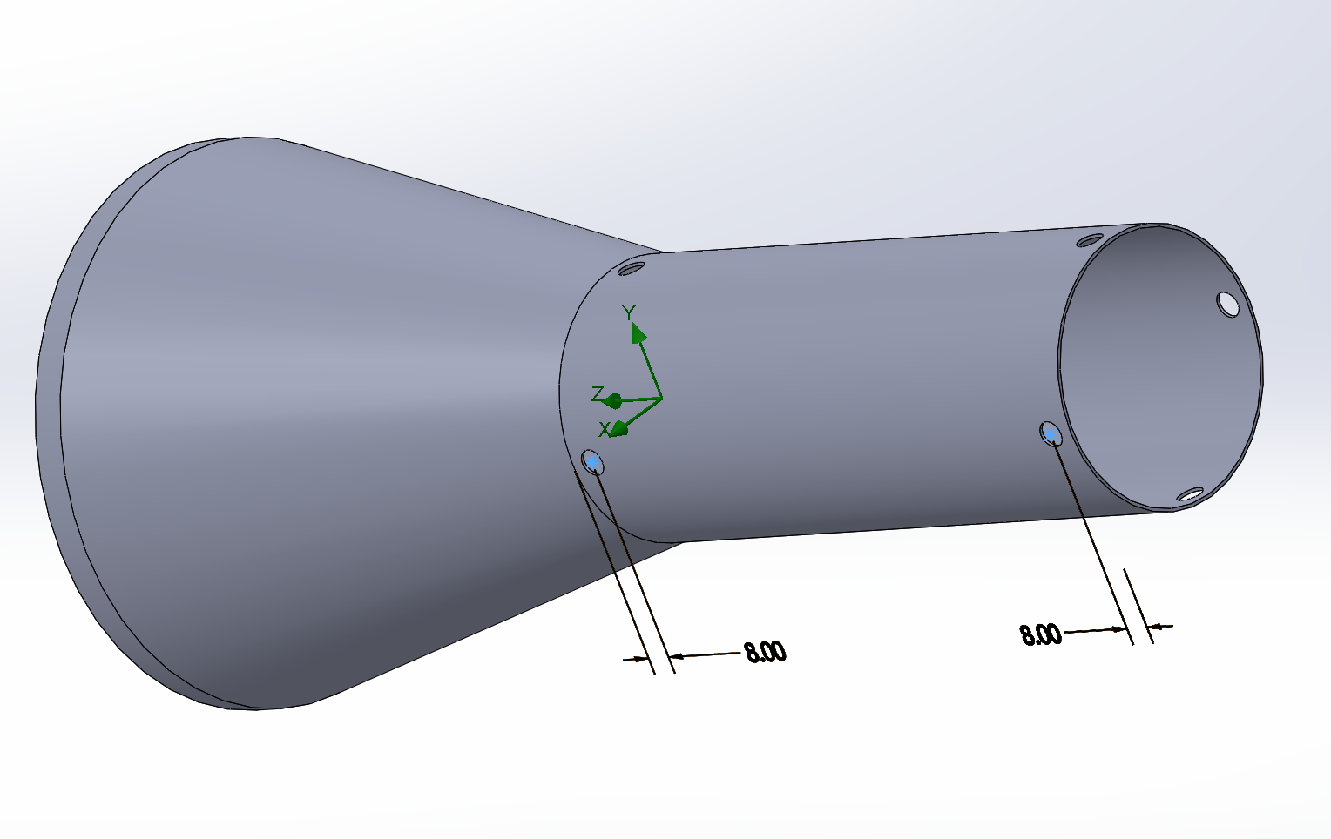
WGA Current Design
Through holes have 4mm diameter and are 4mm away from the edge of the WGA

Slide 16
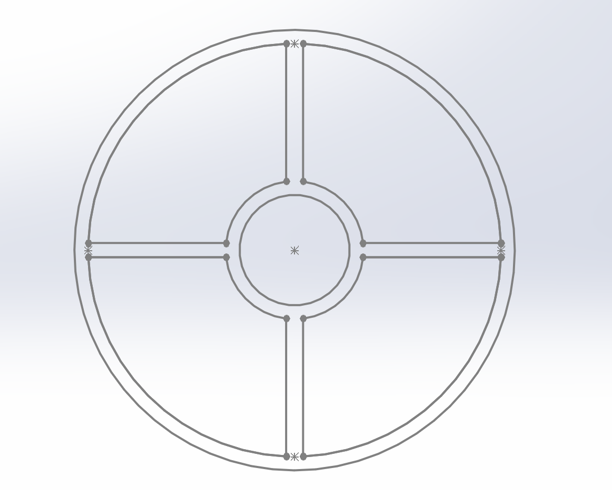
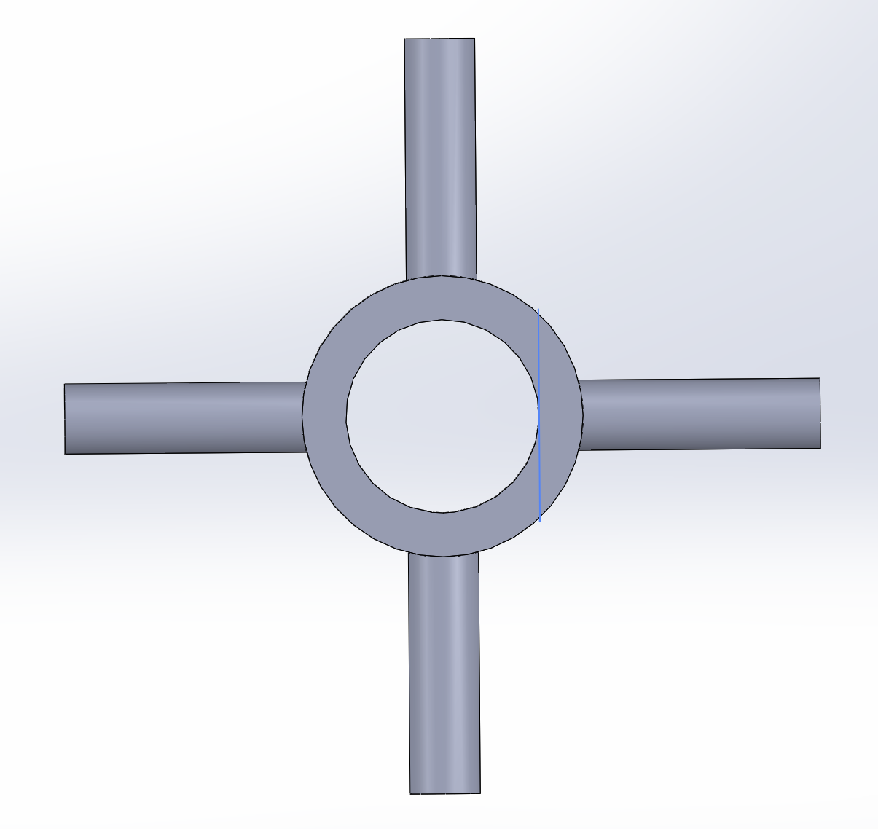
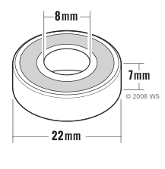
Shaft Holder Design
Old design New design

Slide 17
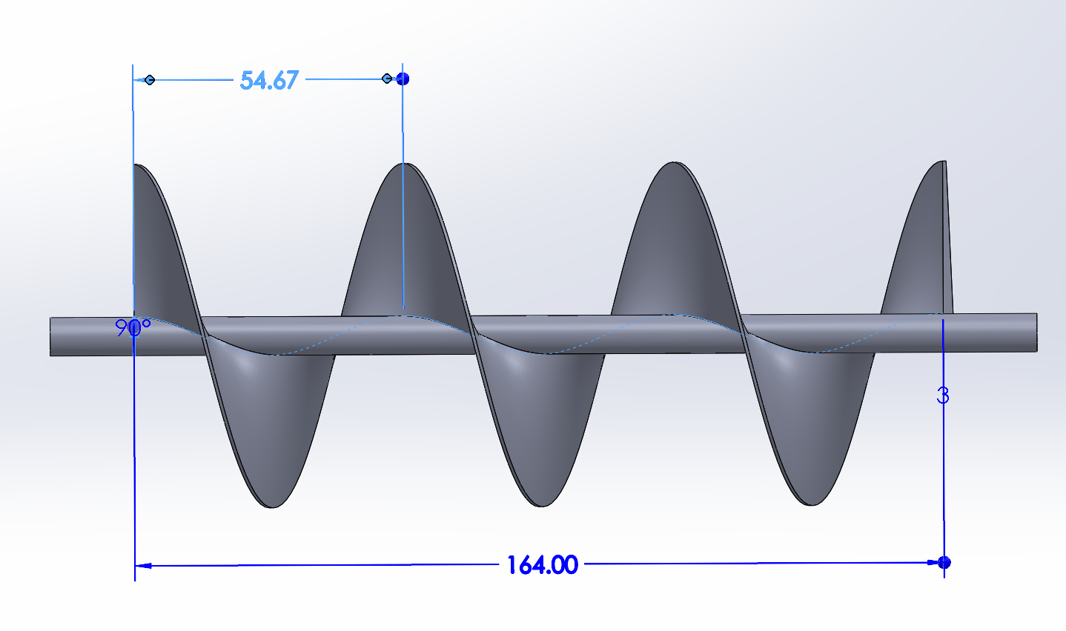
Blade Design
164 mm (length) + 5 mm x2 (clearance) + 8 mm x2 (shaft holders) + 4 mm x2 (cross-section) = 200 mm total length of the Shaft

Slide 18
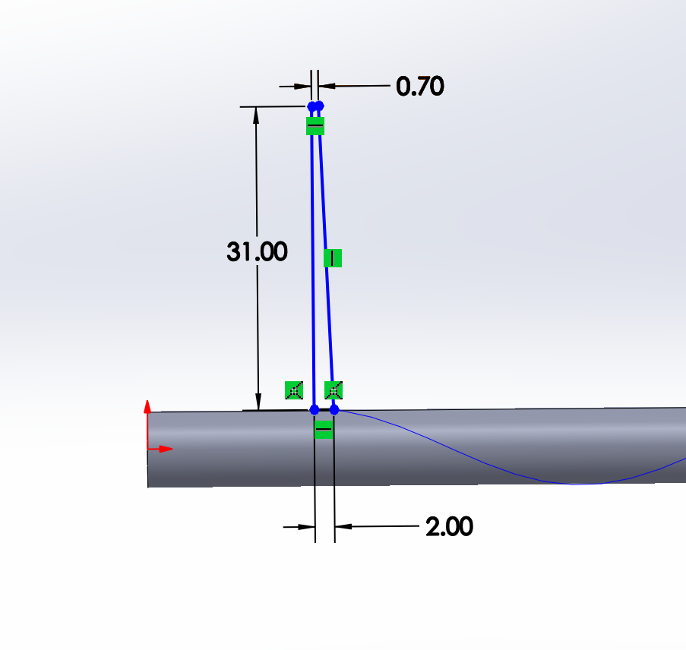
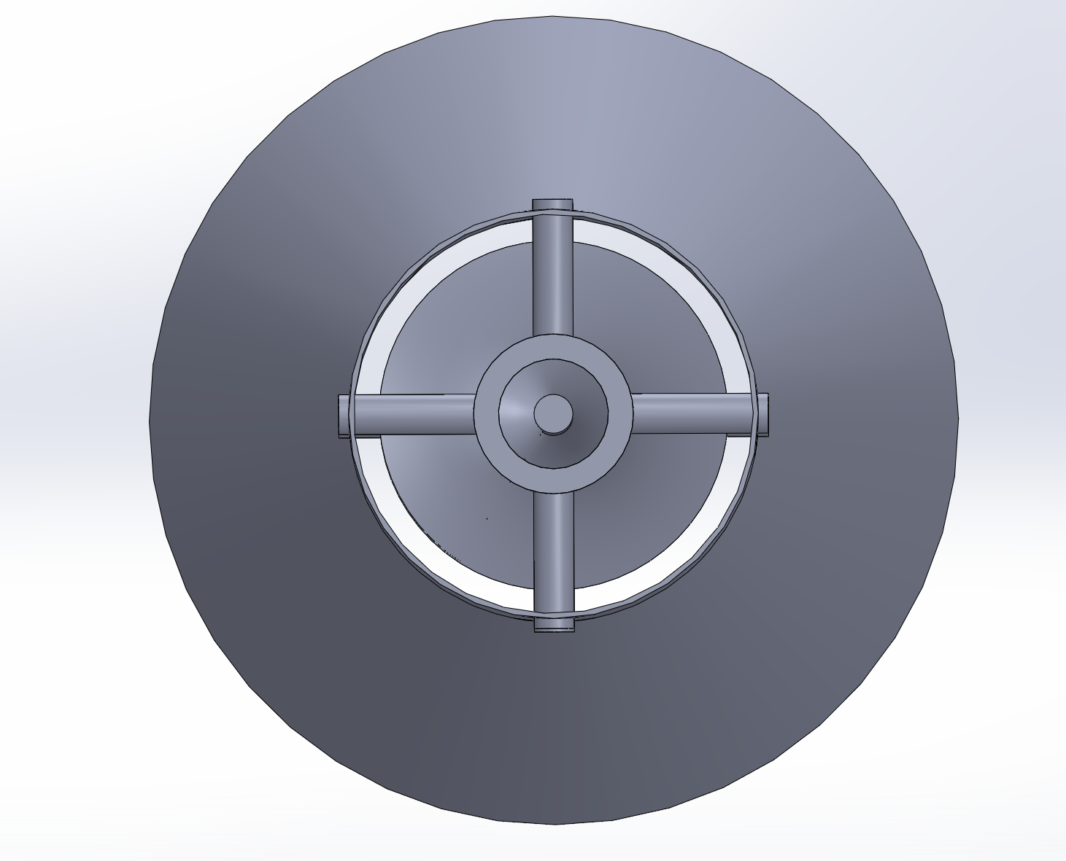
Blade Design
5mm Clearance applies when viewed from the exhaust end

Slide 19
Blade Design
3 Blades to test
1 revolution
2 revolutions
3 revolutions

Slide 20
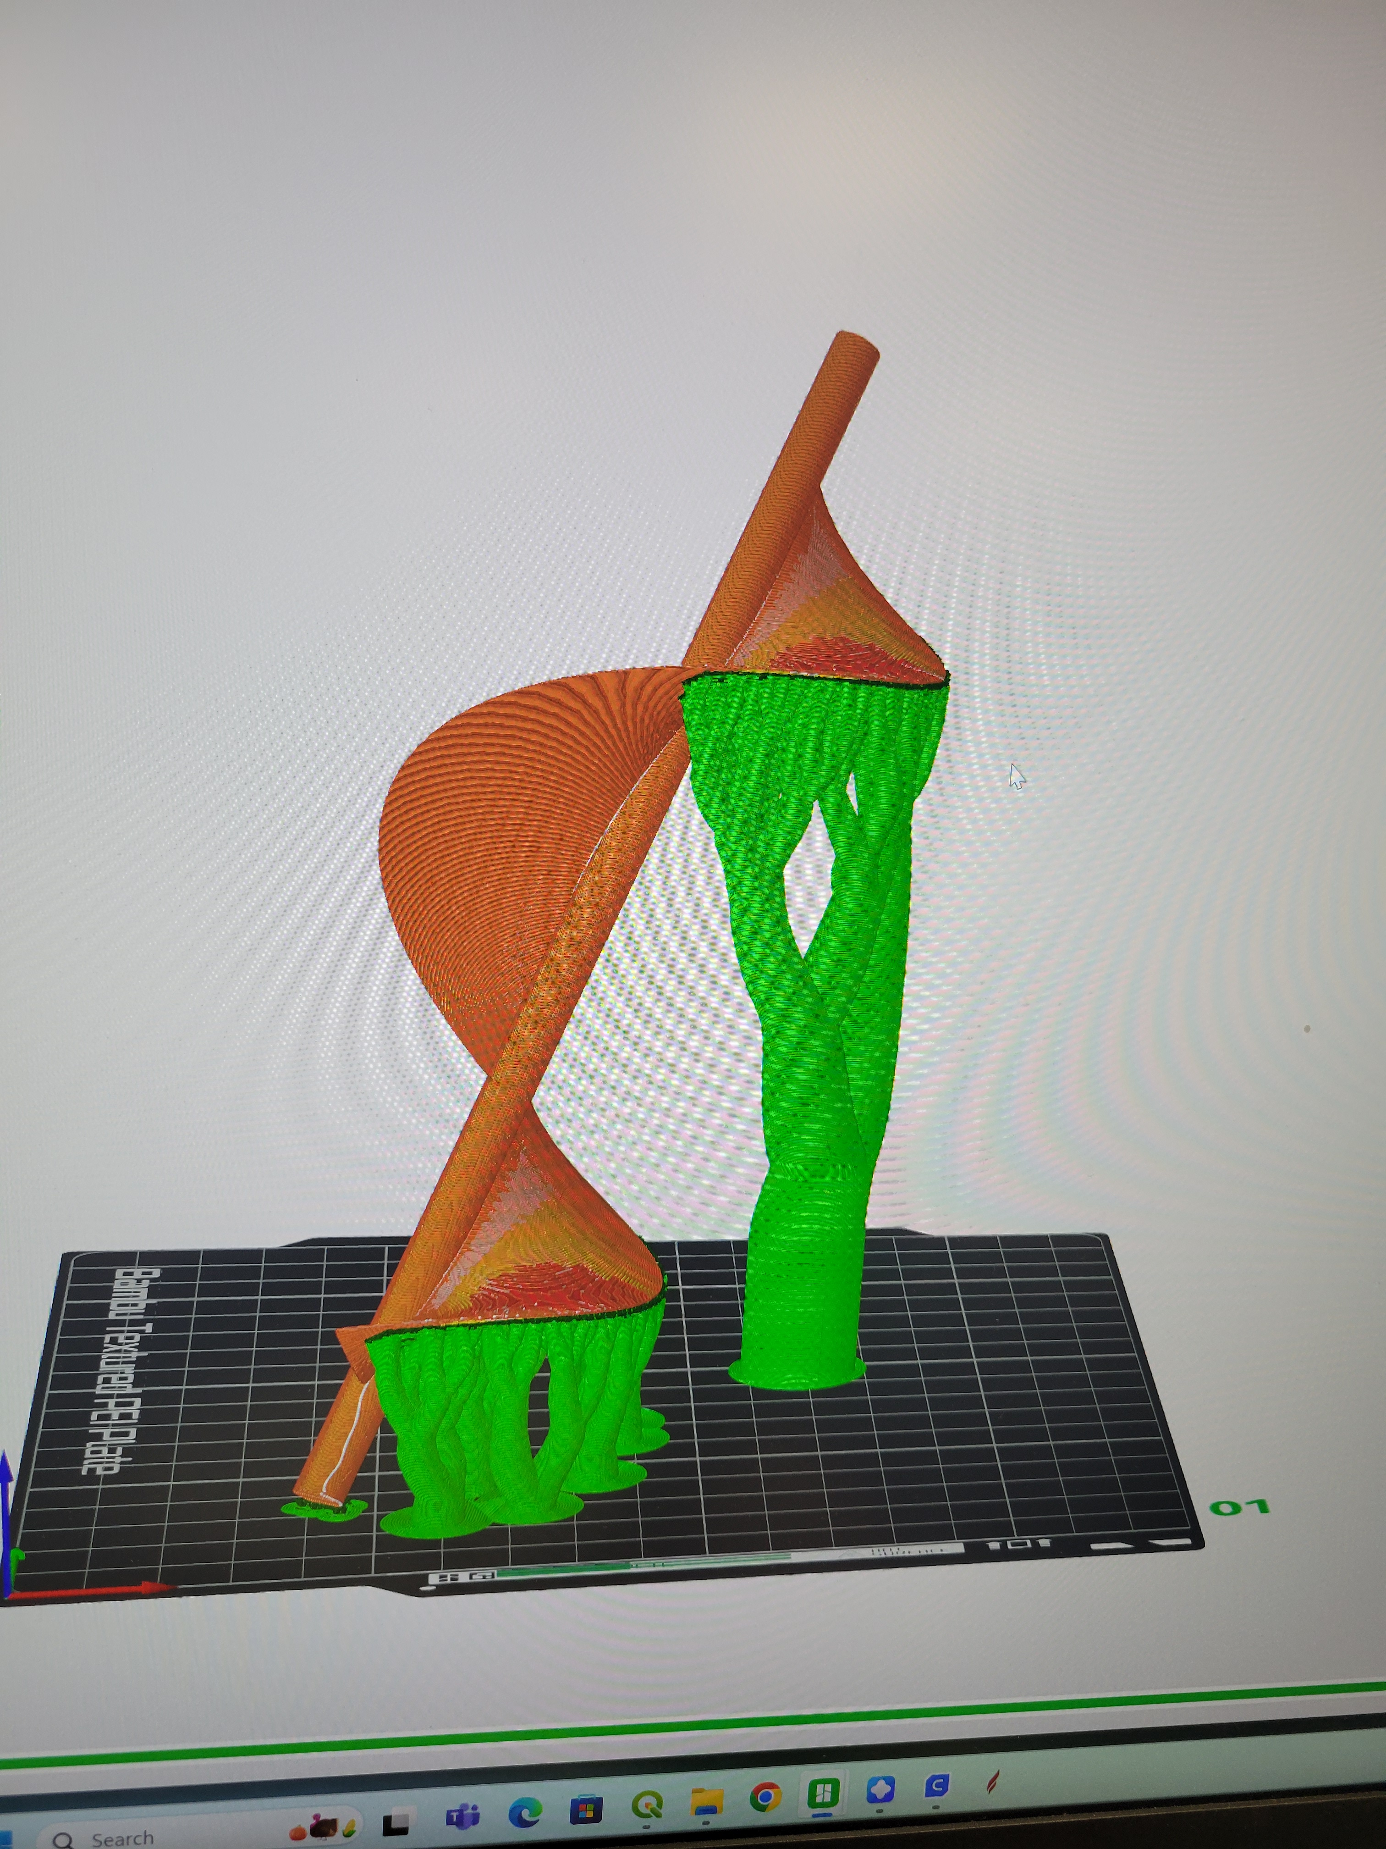
04
3D Printing

Slide 21
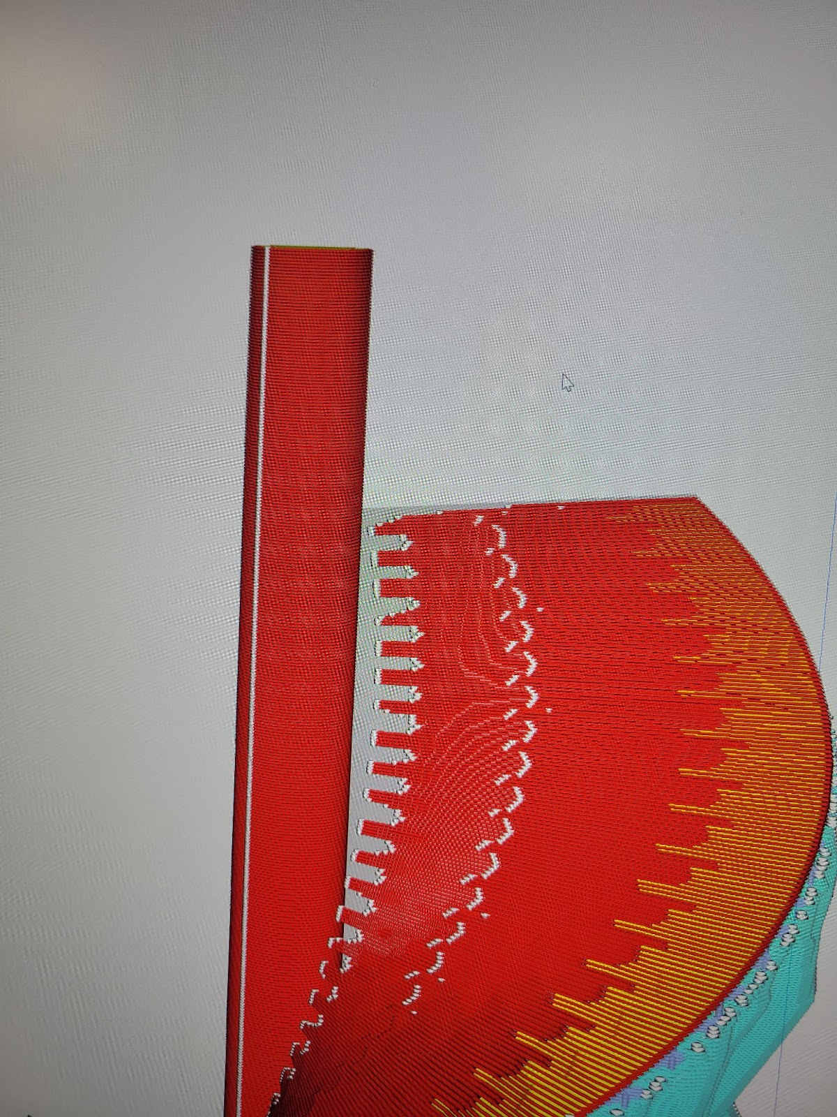
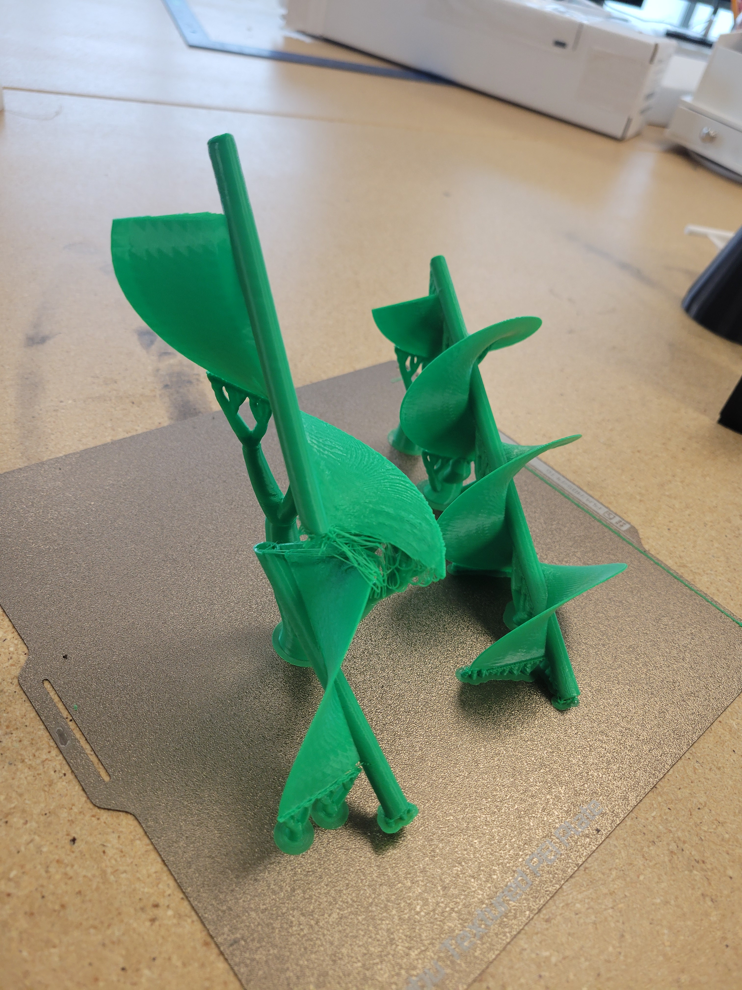
3D Printing
Orientation
Adjustments
Because of the weakness of the layers on top of each other, the blades were printed at an angle
Some model’s glitched in the slicer app. So modifications had to be made.

Slide 22
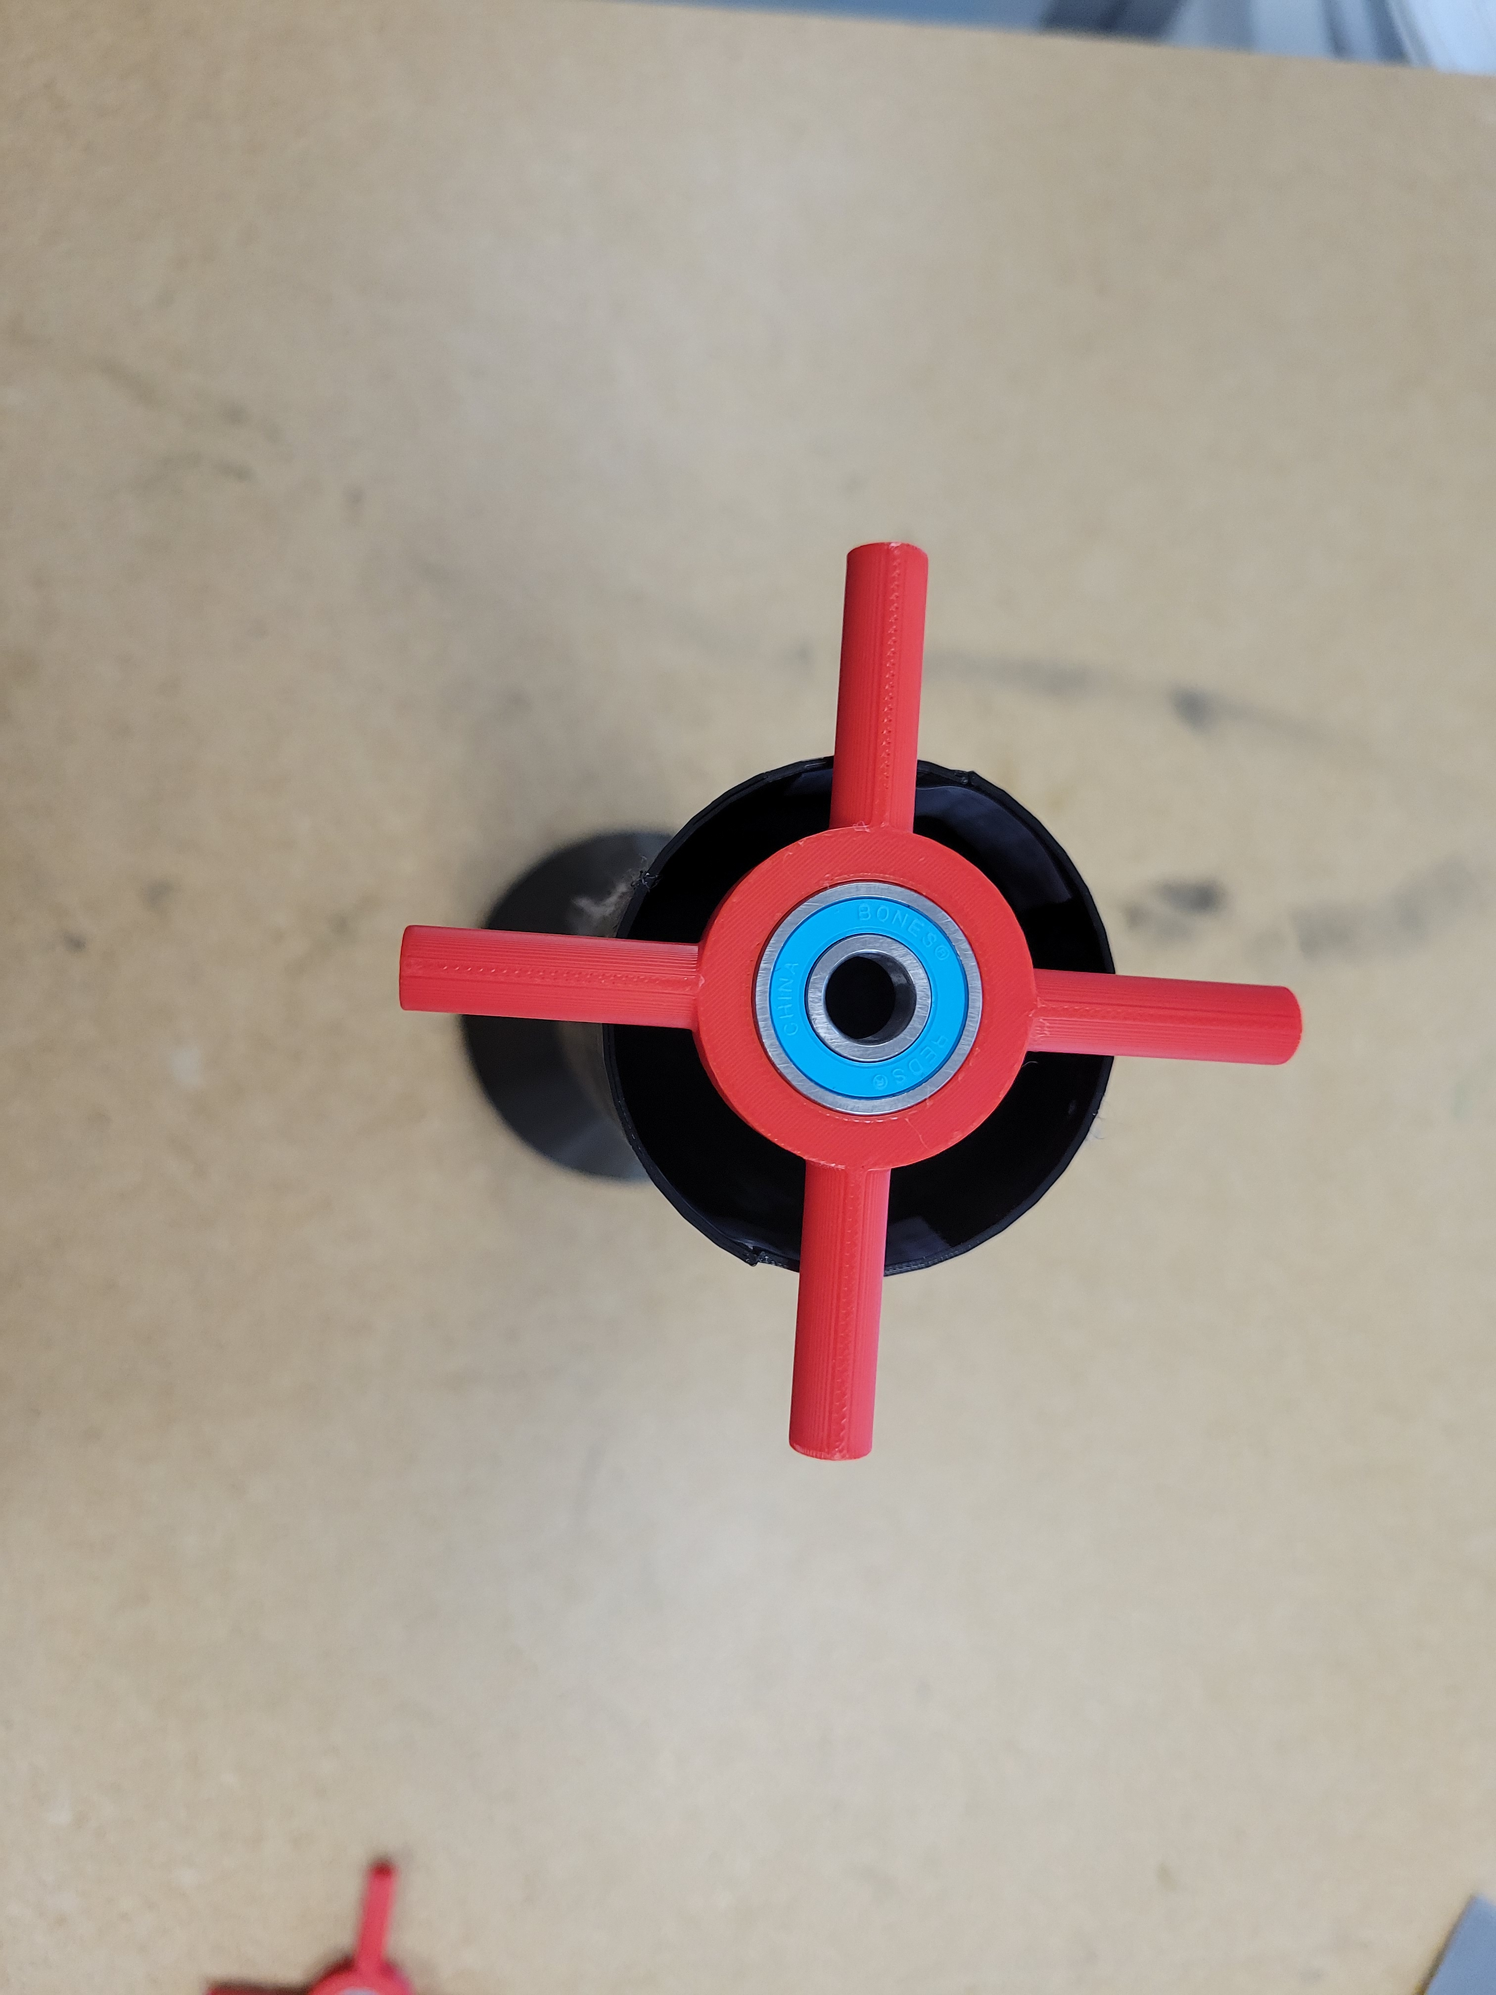
3D Printing
Scaling
WGA in halves
The scale on the slicer was not 100%
The WGA had to be printed in 2 halves so that the blades are easily interchangeable.

Slide 23
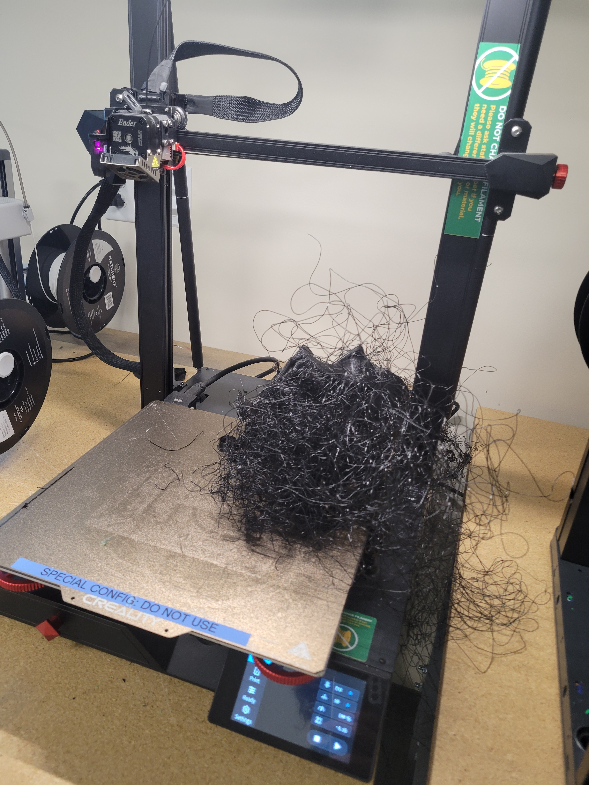
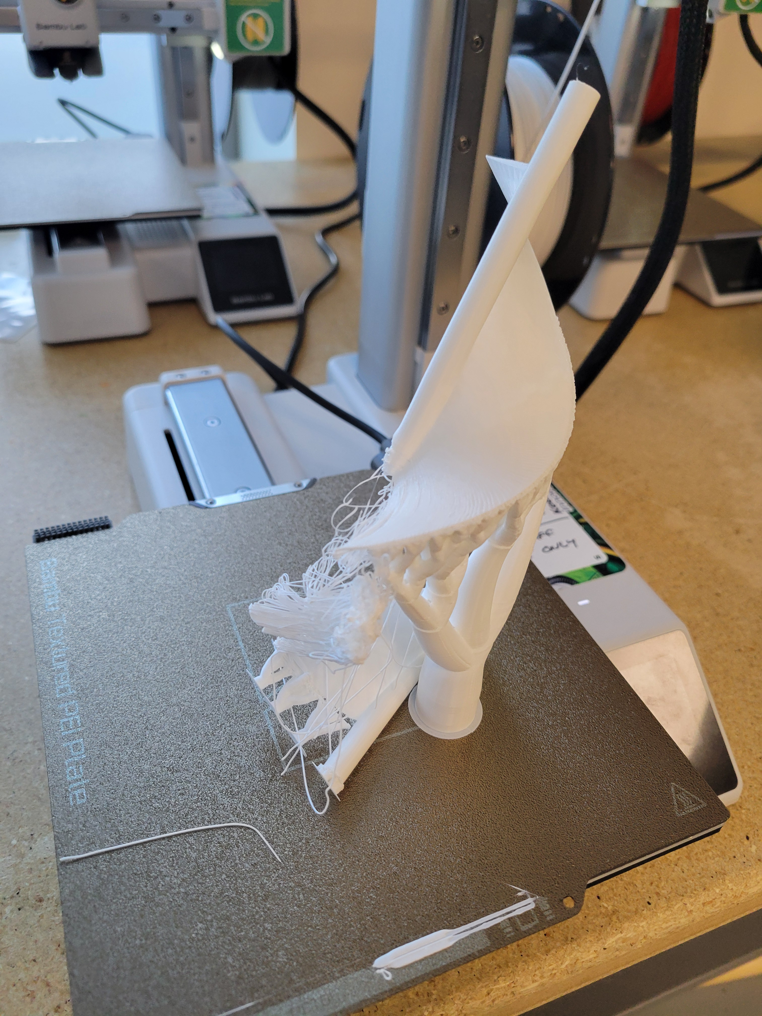
3D Printing Fails

Slide 24
05
Testing

Slide 25
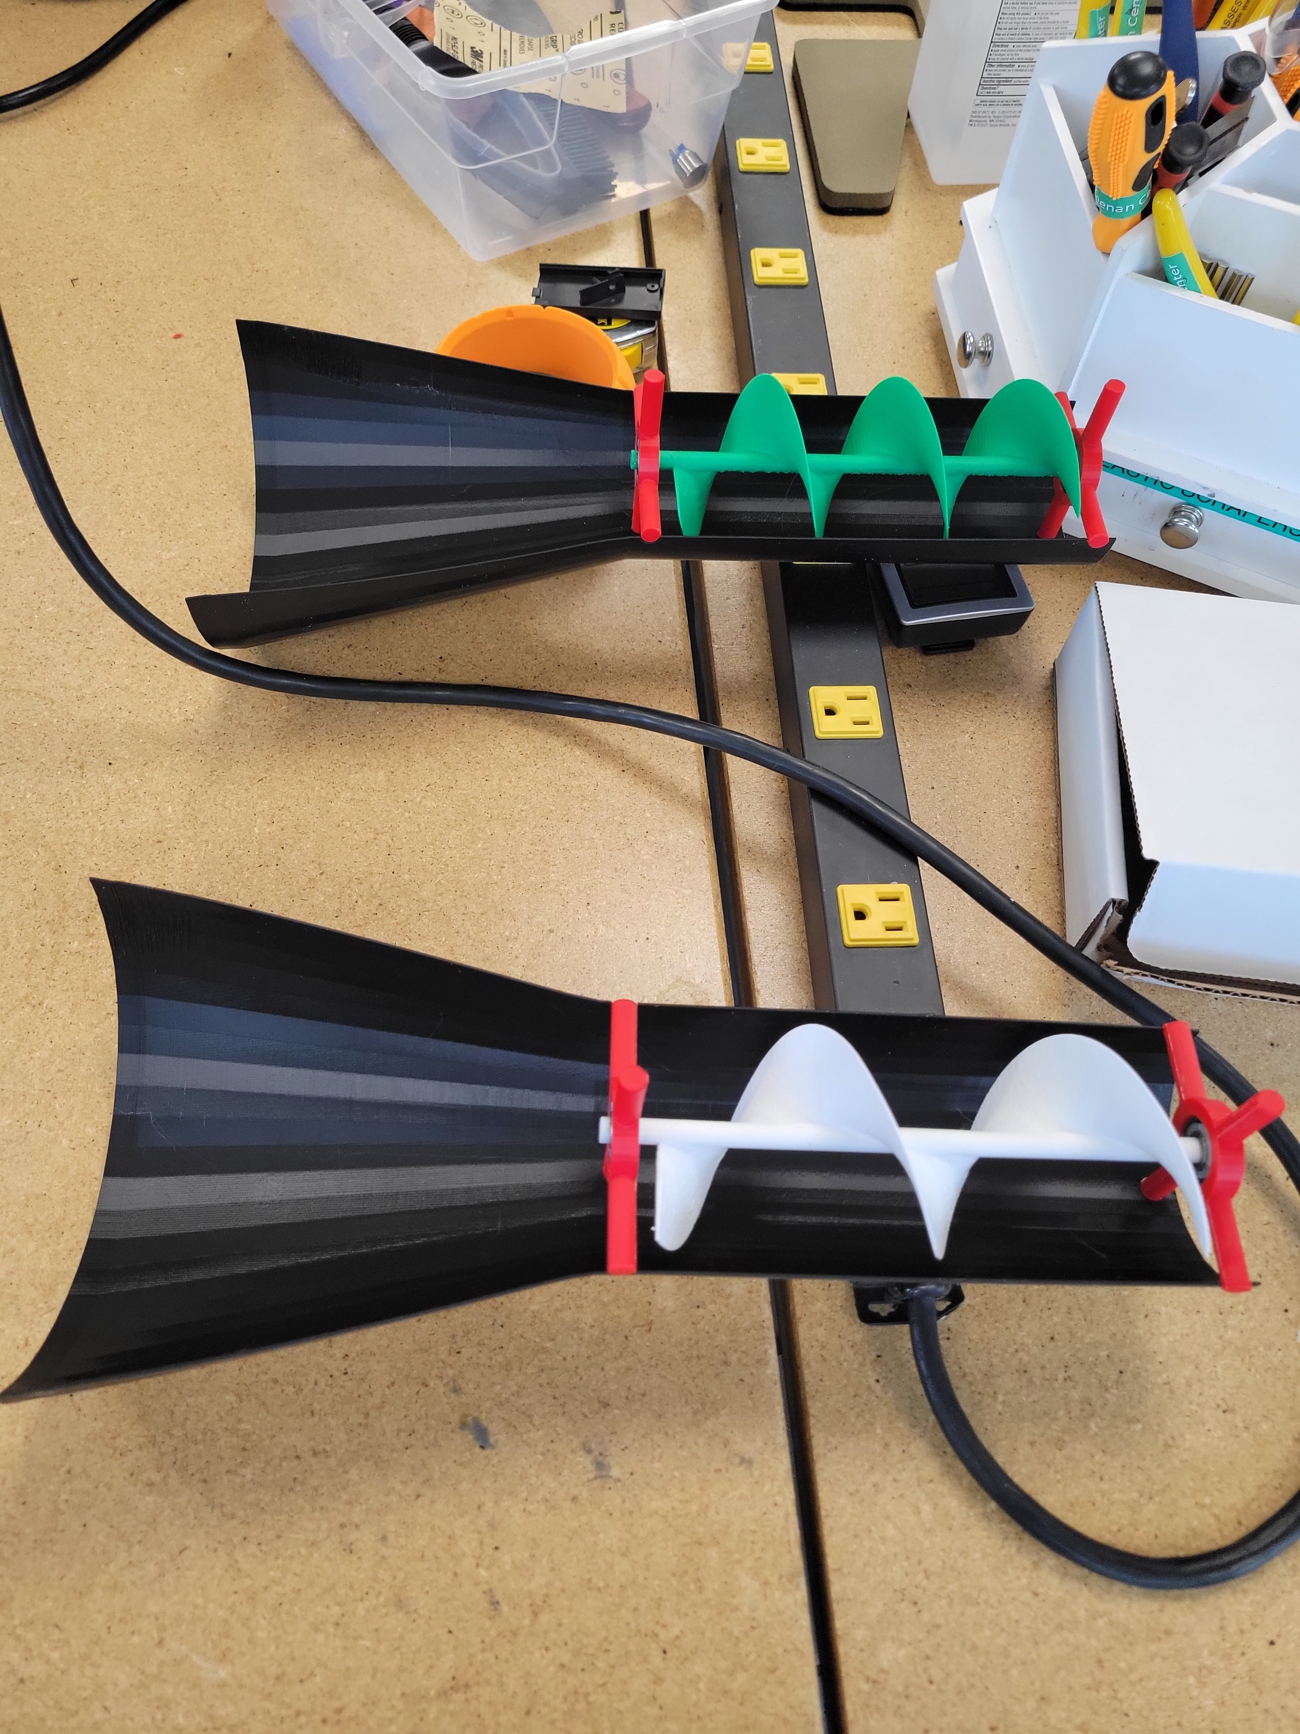
Gluing

Slide 26
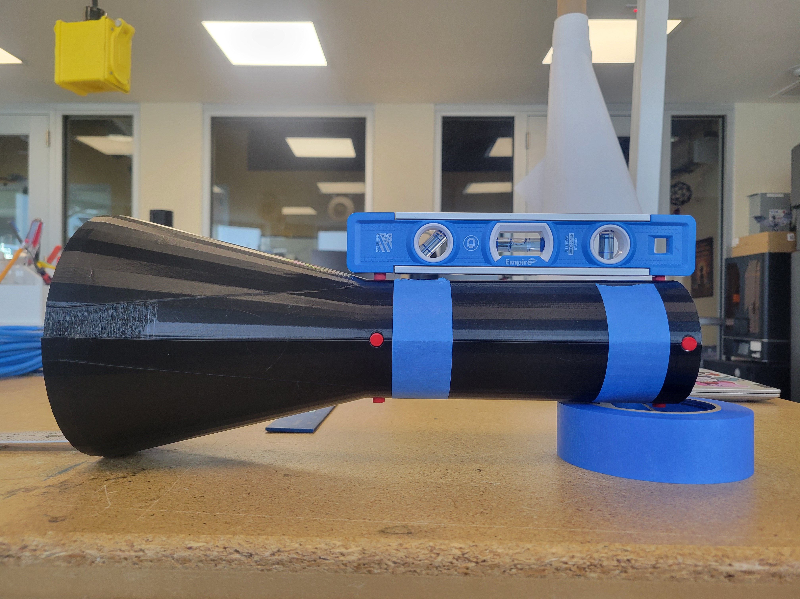
Apparatus
The WGA had to be level with the table and parallel to the wind source for best results

Slide 27
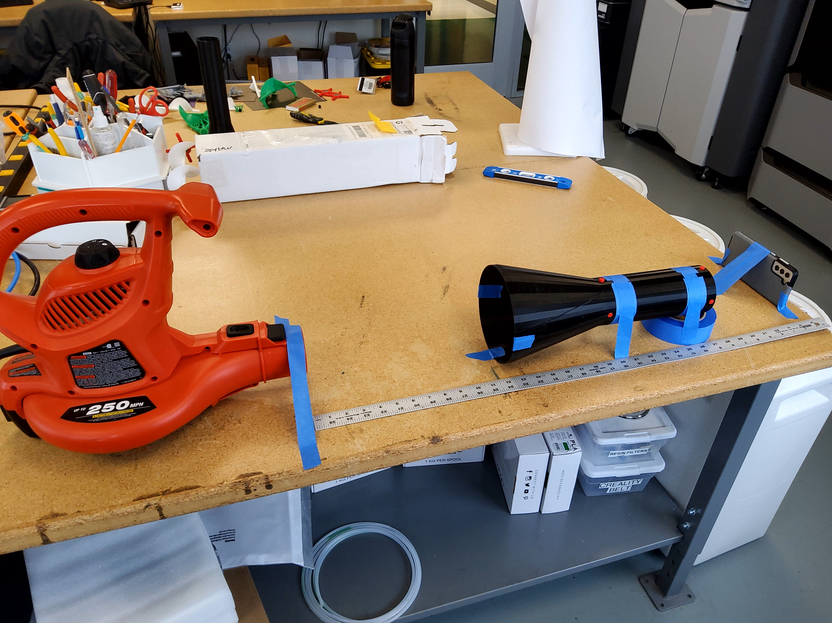
Apparatus
Samsung’s super slow motion takes videos in 960fps and plays back in 30fps
Slows down time by 32%
Video analysis done on Davinci resolve

Slide 28
video

Slide 29
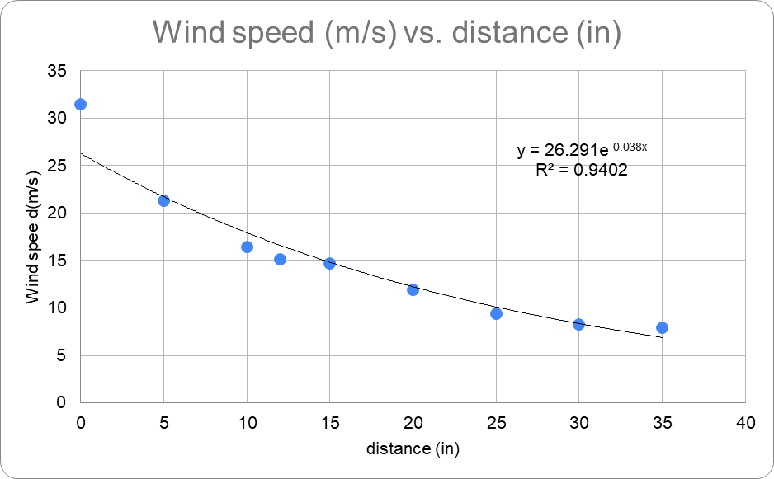
results
Wind speed profile

Slide 30
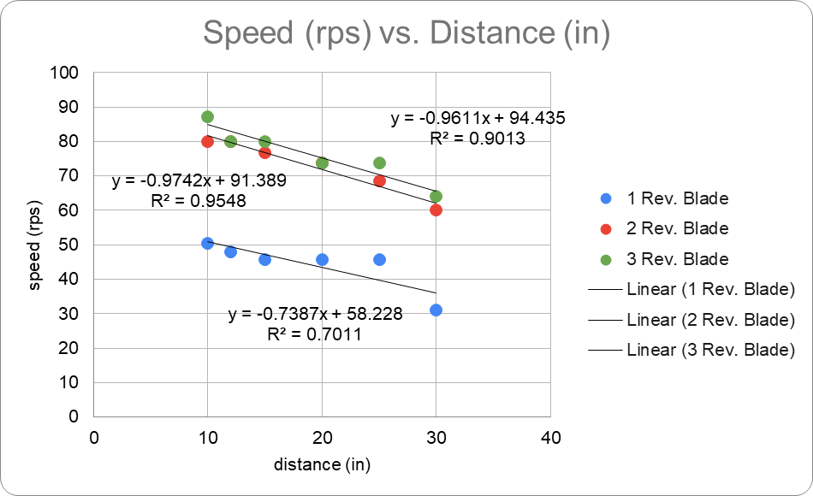
results
Different blades

Slide 31
Conclusion
The 3 revolution blade rotates the fastest given the same conditions for all blades. With this fast rotation, energy could easily be absorbed from the apparatus and easily converted into electrical energy. The

Slide 32
References
https://www.energy.gov/how-does-wind-turbine-work#:~:text=Wind%20turbines%20operate%20on%20a,a%20generator%20to%20create%20electricity.
https://www.energy.gov/eere/wind/advantages-and-challenges-wind-energy
https://www.flydenver.com/art-exhibits/kinetic-air-light-curtain/
https://www.princeton.edu/~asmits/Bicycle_web/Bernoulli.html
https://www.warehouseskateboards.com/help/Skateboard-Bearings-Buying-Guide?srsltid=AfmBOopSu563cAdR4v6xIFo-dItIZyIAgJNw3DNl02MAUYUsIn0pfZhM

Slide 33
Thanks!
Any questions?
Please keep this slide for attribution

